Slide 1

Yash Chatniwala
Aspiring Data Analyst
Movie Revenue & Performance Analysis Using Data Analytics and Machine Learning
Project Journey
Introduction 1.
Introduction 1.6
Market Overview 3.
Market Overview 4.
Market Overview 2.
Market Overview 5.
Tools & Technologies : Python | SQL | Power BI | Tableau | Machine Learning | Virtual Studio

Slide 2
Project Journey
Introduction 1.
Market Overview 3.
Market Overview 4.
Market Overview 2.
Market Overview 5.

Slide 3
Project Journey
Introduction 1.
Market Overview 3.
Market Overview 4.
2. Tools Used
Market Overview 5.

Slide 4
Introduction :
With the rapid growth of the film industry, large amounts of movie-related data are generated every year. Analyzing this data can help uncover meaningful patterns related to movie ratings, revenue, and audience preferences. This project focuses on analyzing a movie dataset using data analysis and machine learning techniques to gain valuable insights. By studying trends and patterns, the project aims to support data-driven decision-making in the entertainment industry.
Introduction 1.
Market Overview 3.
Market Overview 4.
2. Tools Used
Market Overview 5.
3. Data Analysis & Modeling Overview
Objectives :
To analyze a movie dataset and identify key trends and patterns.
To clean, process, and explore the data for meaningful insights.
To apply machine learning algorithms to predict movie ratings and revenue.
To identify optimal groups or clusters of top-rated movies.
To demonstrate modular coding practices and strong analytical skills.

Slide 5
Focus Areas
Introduction 1.
Market Overview 3.
Market Overview 4.
2. Tools Used
Market Overview 5.
3. Data Analysis & Modeling Overview

Slide 6






Tools Used :
Focus Areas
2. Tools Used
Market Overview 5.
1.
3. Data Analysis & Modeling Overview
4.

Slide 7
Project Journey : Step by Step
Data Cleaning & Understanding
Conclusion & Recommendations
Statistical Testing
Focus Areas
2. Tools Used
Market Overview 5.
1.
3. Data Analysis & Modeling Overview
4.
1
3
5
2
4
EDA & Descriptive Analysis
Model Building & Prediction

Slide 8
Data Cleaning and Organization Summary:
Understanding Provided Data (each columns)
Treating JSON columns before Data cleaning
Cleaned Data using Excel and Python
Focus Areas
2. Tools Used
Market Overview 5.
1.
3. Data Analysis & Modeling Overview
Data Understanding
4.
Data Formatting
Data Cleaning

Slide 9
3. Data Analysis & Modeling Overview
Focus Areas
2. Tools Used
Market Overview 5.
1.
4.

Slide 10
1. Revenue & Financial Performance Analysis
3. Data Analysis & Modeling Overview
Focus Areas
2. fdgdfdf
5.
3.
1.
4.

Slide 11
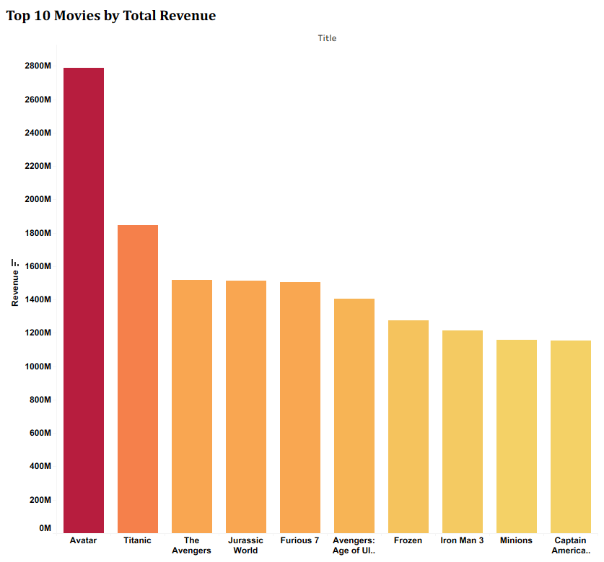
1. Revenue & Financial Performance Analysis
Descriptive Analysis
3. Data Analysis & Modeling Overview
This chart compares the total revenue generated by top-performing movies, highlighting significant differences in their box office success. Avatar leads by a large margin, indicating its exceptional global performance compared to other popular films.
Focus Areas
2. fdgdfdf
5.
3.
4.
1.

Slide 12
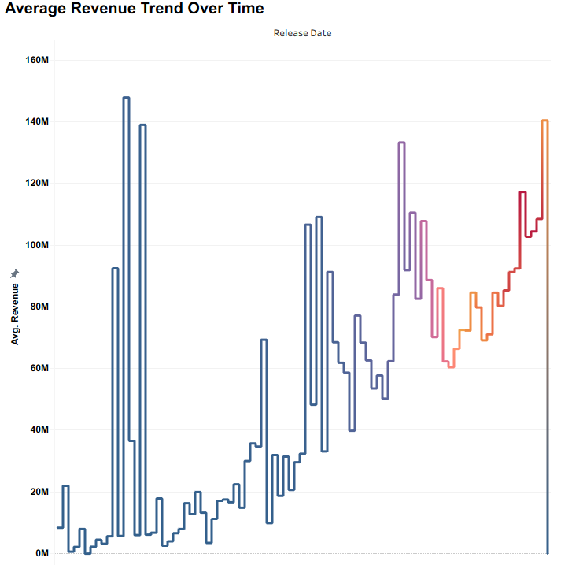
1. Revenue & Financial Performance Analysis
Descriptive Analysis
This chart illustrates the change in average revenue per movie across different release years. The overall upward trend indicates that movies released in recent years generate higher average revenue compared to earlier periods.
Focus Areas
5.
4.
2. fdgdfdf
3.
1.

Slide 13
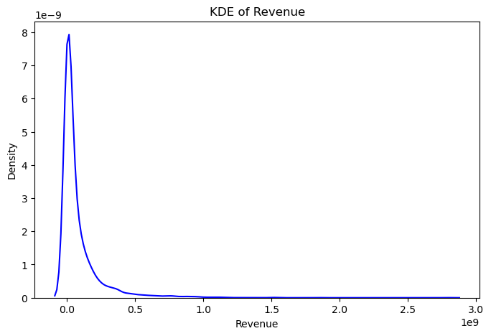
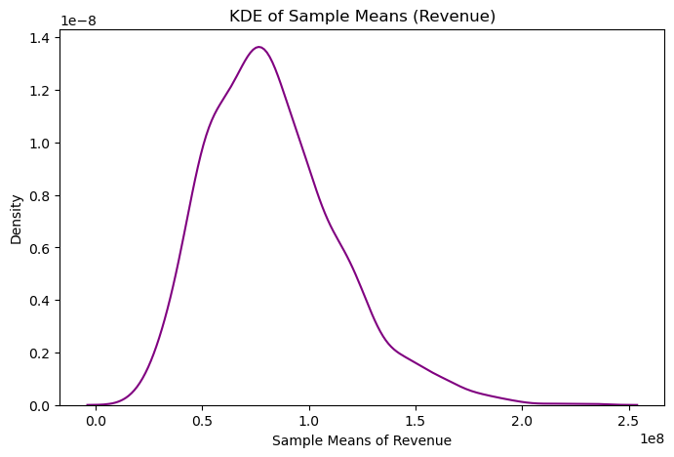
1. Revenue & Financial Performance Analysis
Central Limit Theorem
Focus Areas
2. fdgdfdf
3.
5.
1.
4.
KDE of Revenue:
The original revenue distribution is highly right-skewed, indicating that most movies earn low to moderate revenue while a few blockbuster films earn extremely high revenue.
KDE of Sample Means (Revenue):
The distribution of sample means is approximately normal and more symmetric, demonstrating the Central Limit Theorem where averaging reduces skewness and stabilizes the distribution.
These plots together confirm that even when raw data is skewed, the sampling distribution of the mean tends toward normality.

Slide 14
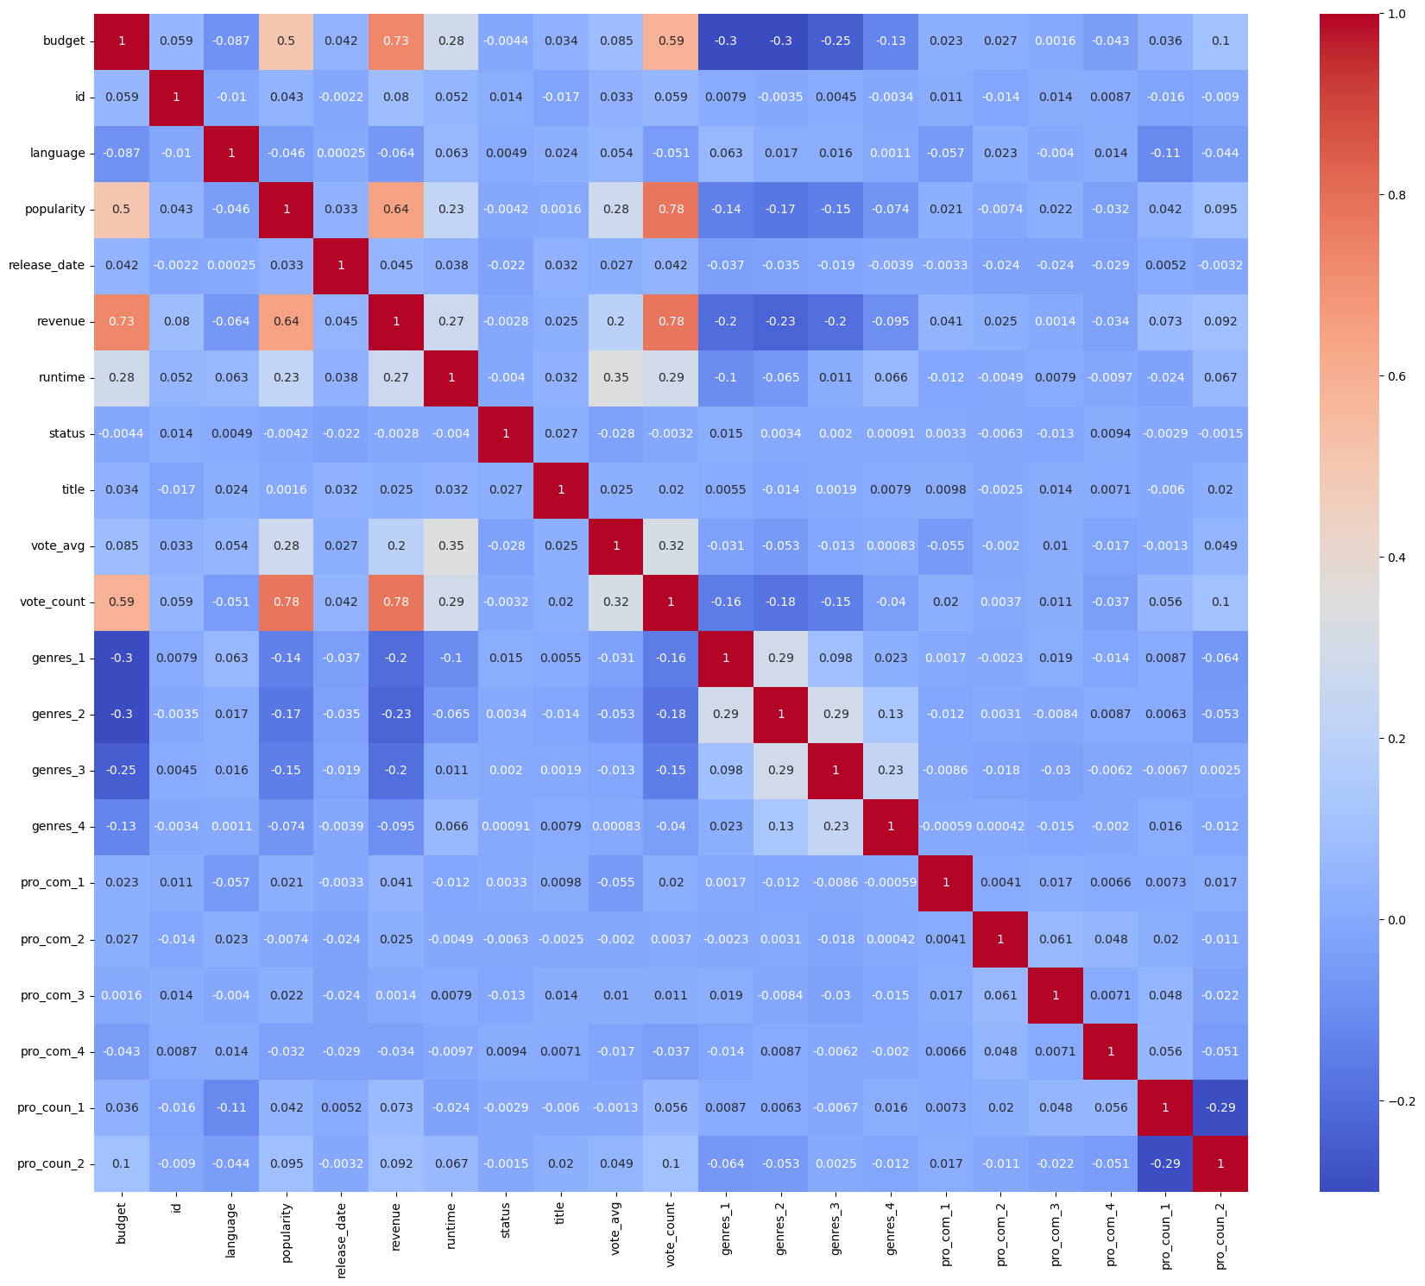
1. Revenue & Financial Performance Analysis
Linear Regression Model for Revenue Amount Prediction
Based on correlation analysis and model testing, the top features for predicting player goals are:
Focus Areas
5.
Budget
Popularity
Run Time
Vote Average
Vote Count
4.
2. fdgdfdf
3.
1.
Building and Testing the Predictive Model :
Model Performance:
Mean Absolute Error (MAE): 0.28
Mean Squared Error (MSE): 0.31
R2 Score: 0.71
RMSE: 0.56
These scores show the model predicts well and can be trusted for analysis.

Slide 15
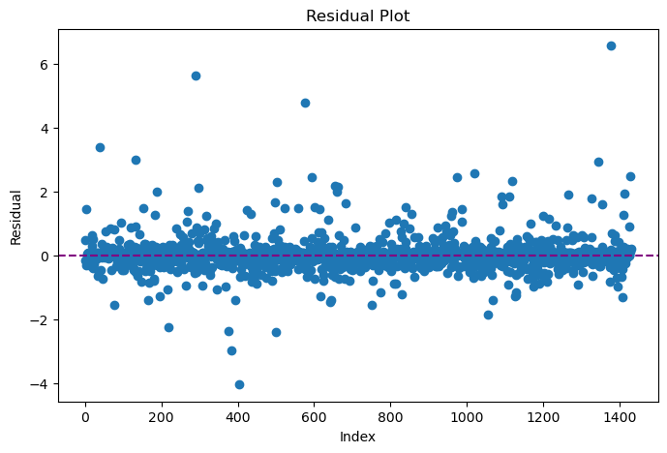
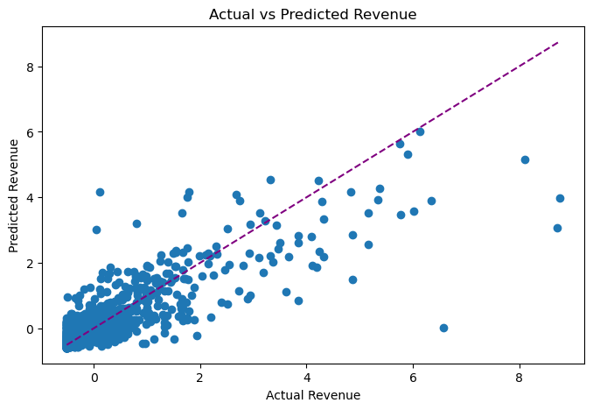
1. Revenue & Financial Performance Analysis
Residual plot & Actual vs Predicted Revenue :
Focus Areas
5.
4.
2. fdgdfdf
3.
1.
Residual Plot: The residuals are randomly scattered around the zero line, indicating that the model does not show strong bias and fits the data reasonably well, though a few outliers are present.
Actual vs Predicted Revenue: Most points lie close to the diagonal reference line, showing a good alignment between actual and predicted revenue, with some deviations at higher revenue values.
Overall, both charts show our model predicts goals well and the errors are random, which means our model is good.

Slide 16
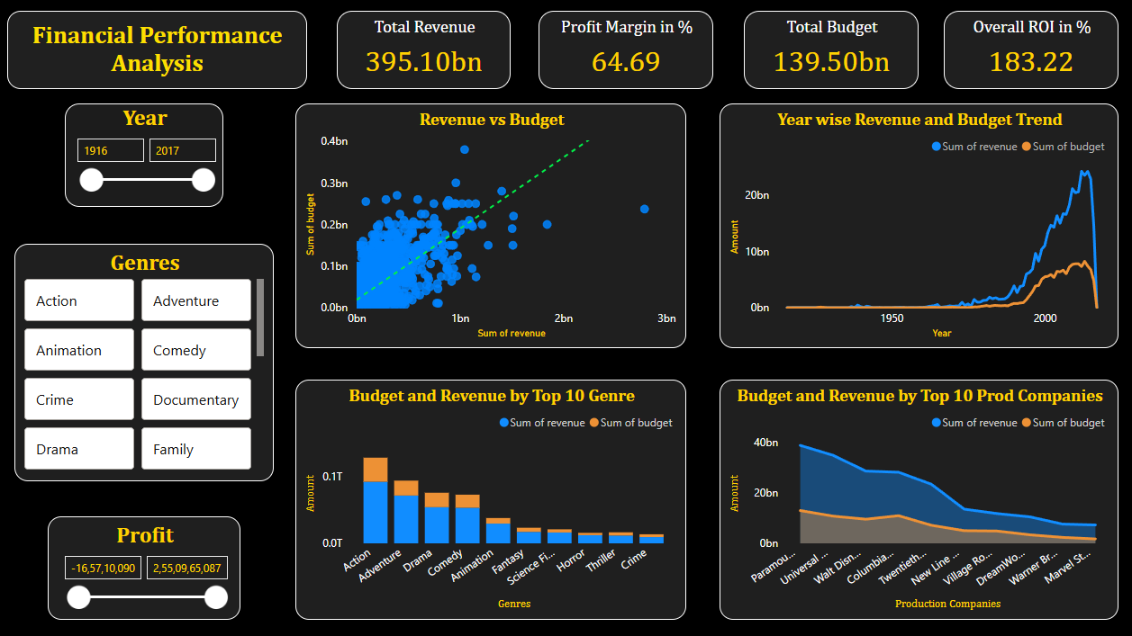
Focus Areas
5.
4.
2. fdgdfdf
3.
1.

Slide 17
2. Audience & Rating Analysis
Probability Analysis – Movie Performance
Event | Description | Probability (%)
P(High Rating) | Movie has rating > 7 | 16.88 %
P(Low Rating ∩ Low Revenue) | Movie has low rating and below-average revenue | 11.57 %
P(High Rating ∪ High Revenue) | Movie is either highly rated or earns high revenue | 37.74 %
P(High Revenue | High Rating) | High revenue given movie is highly rated | 38.39 %
P(High Rating | High Revenue) | High rating given movie earns high revenue | 23.70 %
Focus Areas
5.
4.
2. fdgdfdf
3.
1.
Interpretation :
Movies are more likely to be successful because they earn high revenue than because they receive high ratings.
Only a few movies manage to be successful both in terms of audience ratings and box-office earnings.

Slide 18
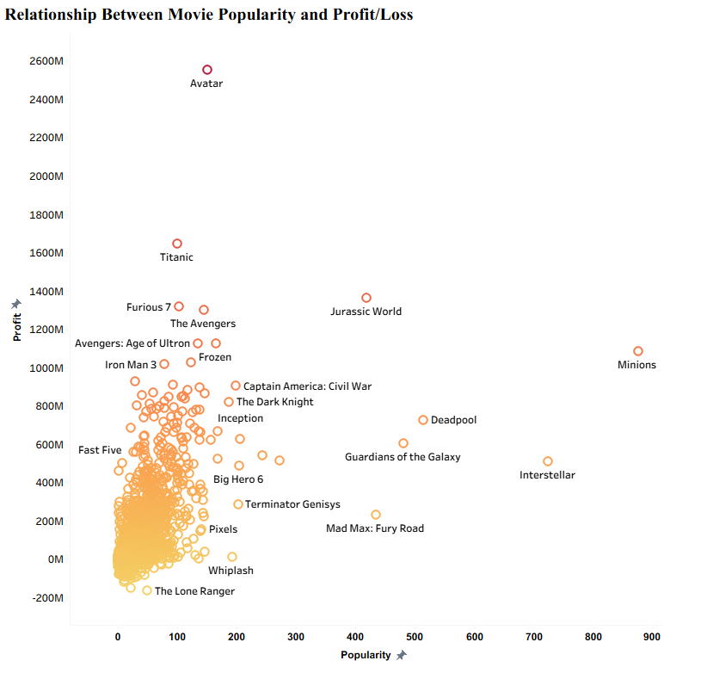
2. Audience & Rating Analysis
Descriptive Analysis
The chart shows that movies with higher popularity generally tend to achieve higher profits. However, several movies generate strong profits even with moderate popularity, while a few popular movies show lower or negative profit, indicating that high popularity does not always guarantee profitability.
Focus Areas
5.
4.
2. fdgdfdf
3.
1.

Slide 19
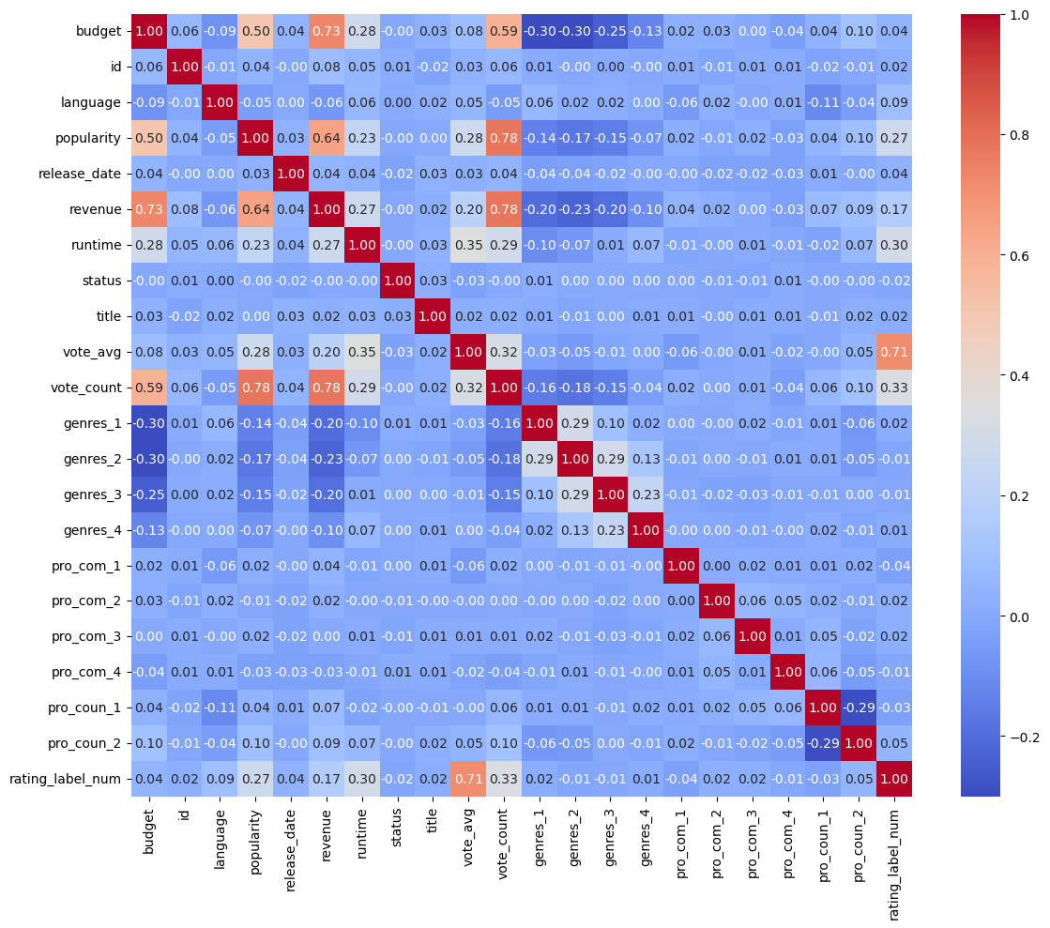
2. Audience & Rating Analysis
Random Forest Classifier Model for Revenue Amount Prediction
Based on correlation analysis and model testing, the top features for predicting Performance are:
Focus Areas
5.
Popularity
Language
Revenue
Run Time
Vote Count
4.
2. fdgdfdf
3.
1.
Building and Testing the Predictive Model :
Model Performance:
Accuracy: 0.75
F1 Score: 0.76
These scores show the model predicts well and can be trusted for analysis.

Slide 20
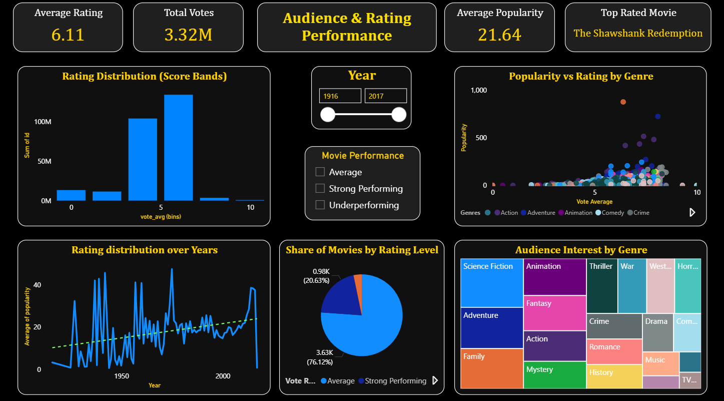
Focus Areas
5.
2. fdgdfdf
3.
4. Summary & Conclusion
1.

Slide 21
Focus Areas
2. fdgdfdf
3.
5.
1.
4. Summary & Conclusion

Slide 22
4. Summary & Conclusion
Focus Areas
2. fdgdfdf
5. Limitation & Recommendations
3.
1.

Slide 23
Summary :
This project analyzed historical movie data to understand revenue drivers, audience behavior, and performance patterns using data analytics and machine learning.
Financial analysis showed that box-office revenue has grown over time, with a small number of blockbuster movies contributing a large share of total revenue.
Audience and rating analysis revealed that commercial success is more common than high audience ratings, indicating that revenue and ratings do not always move together.
Probability analysis quantified business risk by showing that only a limited percentage of movies achieve both high revenue and high ratings, highlighting uncertainty in predicting overall success.
Predictive models demonstrated reasonable accuracy, with improved balance after handling class imbalance, making the insights reliable for decision support rather than exact forecasting.
4. Summary & Conclusion
Focus Areas
2. fdgdfdf
5. Limitation & Recommendations
1.
5.
3.
4.

Slide 24
Conclusion :
Revenue alone should not be used as a proxy for audience satisfaction, as many high-earning movies do not receive strong ratings.
Audience approval and financial performance are influenced by different factors, so studios should evaluate both before making investment or marketing decisions.
The analysis suggests that budget allocation, popularity, and audience engagement metrics play a significant role in driving revenue outcomes.
From a business standpoint, data-driven insights can help production houses manage risk, optimize budgets, and set realistic performance expectations.
Overall, this project demonstrates how data analytics enables informed decision-making in the entertainment industry, supporting strategic planning rather than relying solely on intuition.
4. Summary & Conclusion
Focus Areas
2. fdgdfdf
1.
3.
4.
5. Limitation & Recommendations

Slide 25
4. Summary & Conclusion
Focus Areas
5. Limitation & Recommendations
2. fdgdfdf
1.
3.
4.

Slide 26
Limitations :
Profit is estimated as Revenue minus Budget and does not include marketing, distribution, or operational costs, which may affect true profitability.
Data imbalance exists in audience rating categories, which can influence model performance despite applying balancing techniques.
Popularity and ratings are proxy metrics and may not fully capture real audience sentiment or long-term brand value.
External factors such as release timing, competition, regional performance, and marketing strategy are not included in the dataset.
Predictive models are based on historical data, so performance may vary for future or changing market conditions.
4. Summary & Conclusion
Focus Areas
5. Limitation & Recommendations
2. fdgdfdf
1.
3.
Thank You
4.
Recommendations :
Incorporate marketing and distribution cost data to calculate more accurate net profit and ROI.
Use additional audience signals such as reviews, social media sentiment, or streaming performance for deeper insights.
Apply advanced models and feature engineering to further improve prediction accuracy and class-wise performance.
Segment analysis by region, genre, and release period to support more targeted business decisions.
Use insights from this analysis to optimize budget allocation, manage financial risk, and improve movie release strategies.

Slide 27
Focus Areas
5. Limitation & Recommendations
2. fdgdfdf
Thank You
1.
3.
4.

